Slide 1

Dept. of Computer Science and Engineering
University of Rajshahi
www.ru.ac.bd
Dr. Shamim Ahmad

Slide 2
Constructing an ER model
Before beginning to draw the ER model, read the requirements specification carefully.
Document any assumptions you need to make.

Slide 3
Constructing an ER model (cont)
1. Identify entities - list all potential entity types. These are the object of interest in the system. It is better to put too many entities in at this stage and them discard them later if necessary.

Slide 4
Constructing an ER model (cont)
2. Remove duplicate entities - Ensure that they really separate entity types or just two names for the same thing.
Also do not include the system as an entity type
e.g. if modelling a library, the entity types might be books, borrowers, etc.
The library is the system, thus should not be an entity type.

Slide 5
Constructing an ER model (cont)
3. List the attributes of each entity (all properties to describe the entity which are relevant to the application).
Ensure that the entity types are really needed.
are any of them just attributes of another entity type?
if so keep them as attributes and cross them off the entity list.
Do not have attributes of one entity as attributes of another entity!

Slide 6
Constructing an ER model (cont)
4. Mark the primary keys.
Which attributes uniquely identify instances of that entity type?
This may not be possible for some weak entities.

Slide 7
Constructing an ER model (cont)
5. Define the relationships
Examine each entity type to see its relationship to the others.

Slide 8
Constructing an ER model (cont)
6. Describe the cardinality and optionality of the relationships
Examine the constraints between participating entities.

Slide 9
Constructing an ER model (cont)
7. Remove redundant relationships
Examine the ER model for redundant relationships.

Slide 10
Constructing an ER model (cont)
ER modelling is an iterative process
So draw several versions, refining each one until you are happy with it
Note that there is no one right answer to the problem, but some solutions are better than others!

Slide 11
Problem (story) : National Bus Company
The National Bus Company owns a number of busses. Each bus is allocated to a particular route, although some routes may have several busses. Each route passes through a number of towns.

Slide 12
Problem (story) : National Bus Company
One or more drivers are allocated to each stage of a route, which corresponds to a journey through some or all of the towns on a route.

Slide 13
Problem (story) : National Bus Company
Some of the towns have a garage where busses are kept and each of the busses are identified by the registration number and can carry different numbers of passengers, since the vehicles vary in size and can be single or double-decked.

Slide 14
Problem (story) : National Bus Company
Each route is identified by a route number and information is available on the average number of passengers carried per day for each route. Drivers have an employee number, name, address, and sometimes a telephone number.

Slide 15
Solution: Entities
Bus - Company owns busses and will hold information about them.
Route - Buses travel on routes and will need described.
Town - Buses pass through towns and need to know about them
Driver - Company employs drivers, personnel will hold their data.
Stage - Routes are made up of stages
Garage - Garage houses buses, and need to know where they are.

Slide 16
Solution: Relationships
A bus is allocated to a route and a route may have several buses.
Bus-route (m:1) is serviced by
A route comprises of one or more stages.
route-stage (1:m) comprises
One or more drivers are allocated to each stage.
driver-stage (m:1) is allocated
A stage passes through some or all of the towns on a route.
stage-town (m:n) passes-through

Slide 17
Solution: Relationships (cont)
A route passes through some or all of the towns
route-town (m:n) passes-through
Some of the towns have a garage
garage-town (1:1) is situated
A garage keeps buses and each bus has one `home' garage
garage-bus (m:1) is garaged

Slide 18
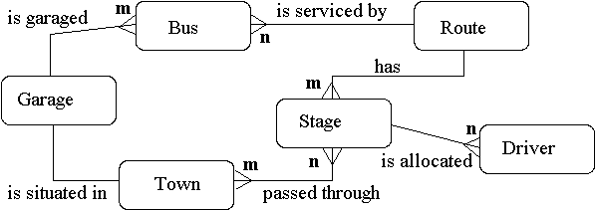
Solution: Draw E-R Diagram

Slide 19
Solution: Relations
Bus (reg-no,make,size,deck,no-pass)
Route (route-no,avg-pass)
Driver (emp-no,name,address,tel-no)
Town (name)
Stage (stage-no)
Garage (name,address)

